Slide 1
Paperless Voucher Training
Archdiocese of Houston – Galveston

Slide 2
Clothing Voucher Guidelines
Each household member will get their own voucher.
Member can redeem vouchers for other household members.
Unredeemed voucher will expire in 30 days.
Limit one voucher per person every six months.
Homeless person is allowed one voucher per month.

Slide 3
Conference/Pantry Workflow
Follow intake process to capture FIN information and create a case.
Generate the voucher.
Print the voucher or provide FIN with instruction to download voucher onto mobile device.
In CMS, record the clothing voucher value in the Assistance tab

Slide 4
Thrift store Workflow
Log into voucher portal using the iPad mini
For walk-in (homeless) FIN, follow instruction to generate a voucher.
Redeem the voucher coupon

Slide 5
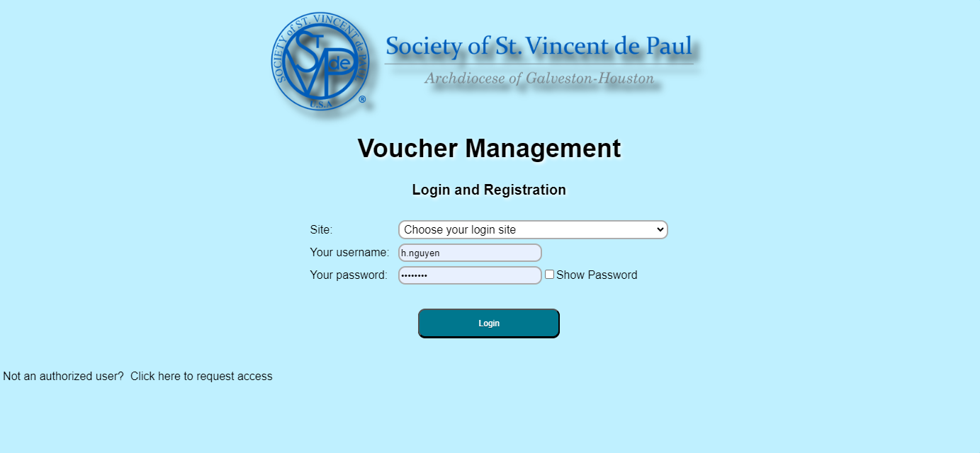
Accessing system
Log into SVDP portal at https://www.svdphouston.info/Vouchers/svdp_Voucher_Frontpage.php
First time user will need to request access by clicking on the button below

Slide 6
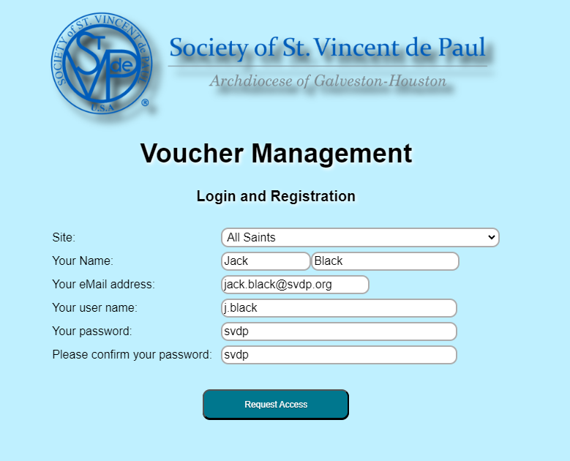
Creating user account
Fill out the require fields and click on the Request Access button

Slide 7
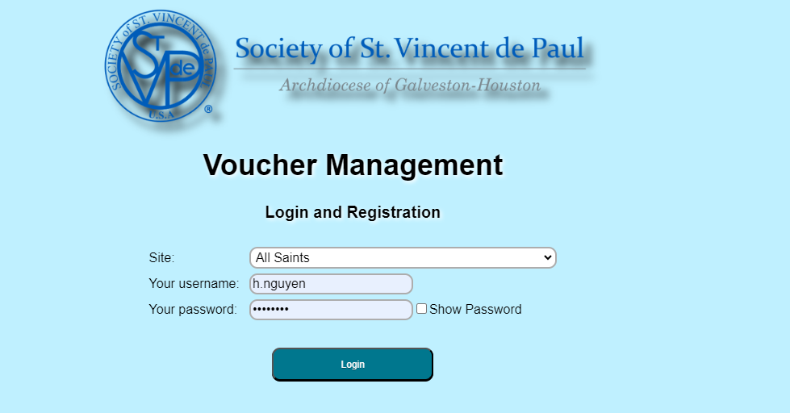
Log in site
Select your site and log in with your credential

Slide 8
Create new client
If the FIN is new and not in the voucher database, create a new client. If unsure, skip this step and go to the next Generate a Voucher step.
Click on the New Client button

Slide 9
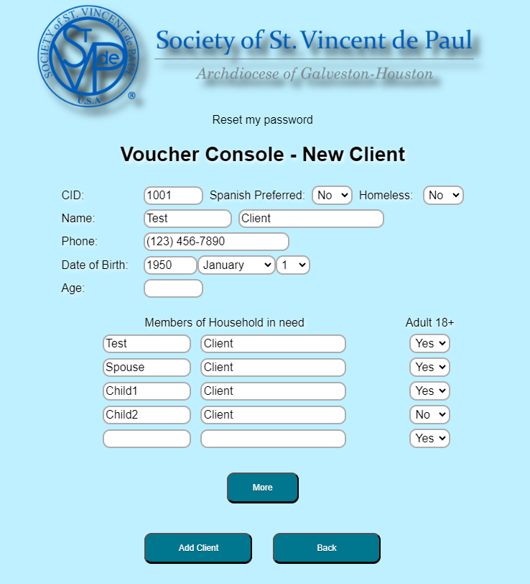
Create new client
Fill out the required fields. The CID and Age will be generated automatically by the program.
If there are multiple people in the same household, enter their names and classification (adult/child).
Click on the Add Client button

Slide 10
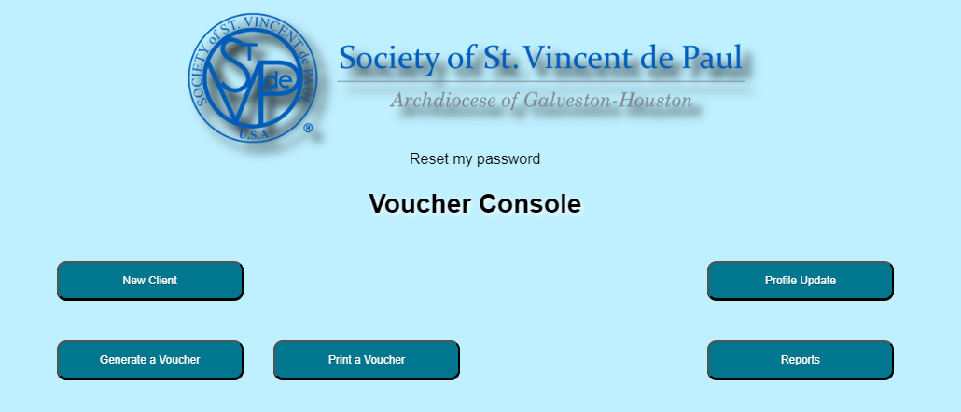
Generate a voucher
Click on the Generate a Voucher button

Slide 11
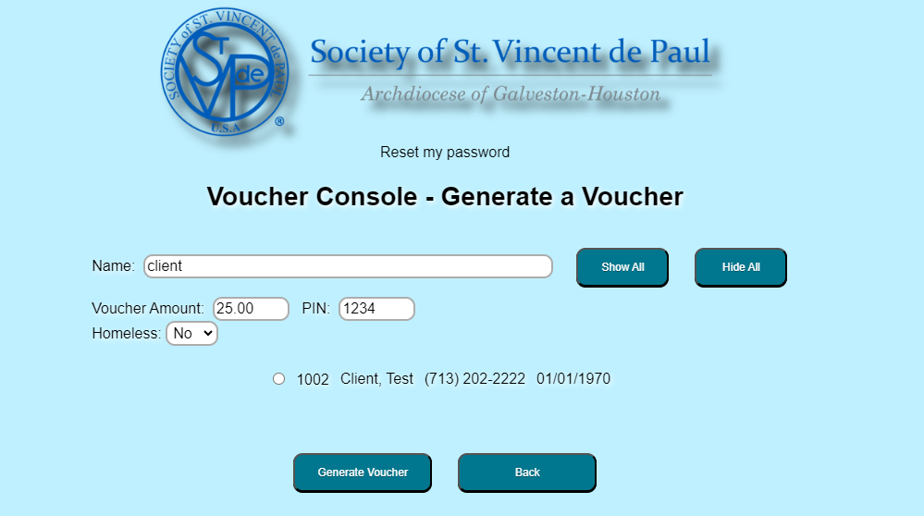
Generate a voucher
Type the FIN’s last name into the search box. A list of possible matches will appear.
Select the correct FIN from the list.
The voucher amount is fixed at $25. Assign a four-digit PIN that the FIN has chosen. This PIN is needed to retrieve their voucher online.
Use the drop-down option if the FIN is homeless.
Click on the Generate Voucher button

Slide 12
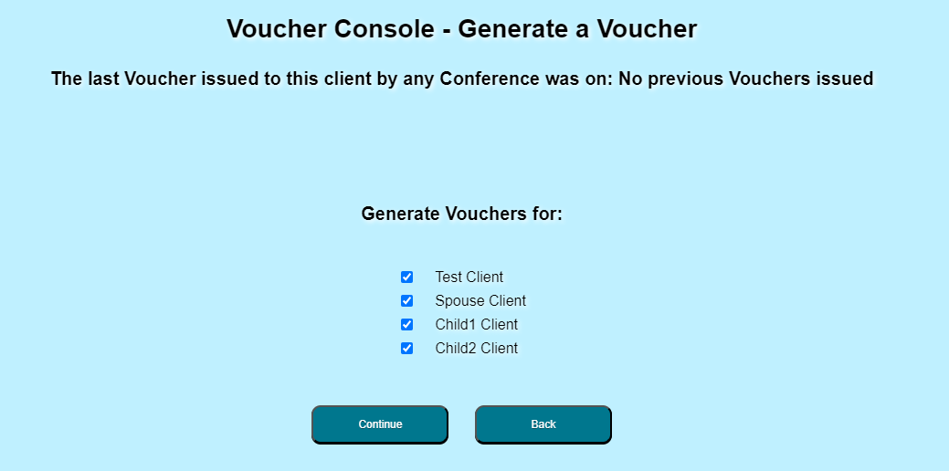
Generate a voucher
If there are multiple people entered under same client profile (household), they will be available to generate voucher.
Click on the box to uncheck the checkmark if you don’t want to issue voucher for this person. A person with the checkmark will get a voucher.
Click Continue button

Slide 13
Print a voucher
Click on the Print a Voucher button

Slide 14
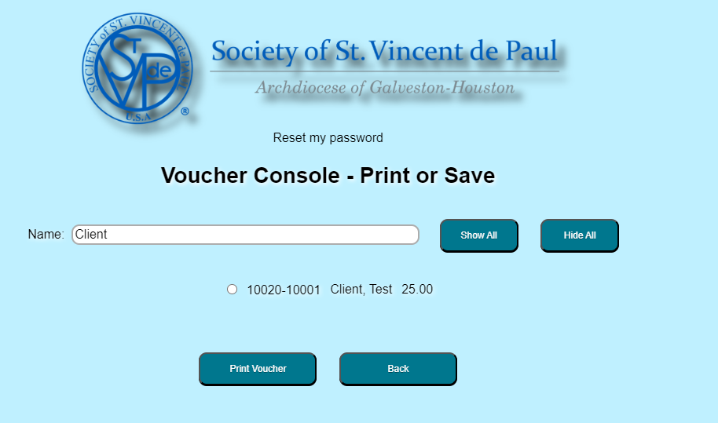
Print a voucher
Type in the FIN’s name in the search box
Click on the radio button to select the correct FIN
Click on the Print Voucher button

Slide 15
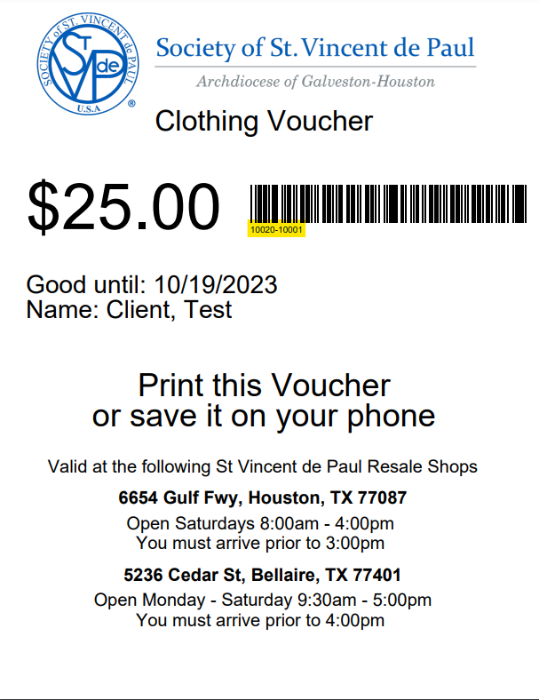
Print a voucher
Below is an example of a clothing voucher. Each voucher will have an unique ID number. The first five digits is the conference code. The last five digits are the serial number.

Slide 16
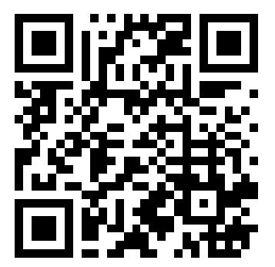
How to save a voucher on a phone
Scan the QR code with a phone to go to https://www.svdphouston.info/Public/

Slide 17
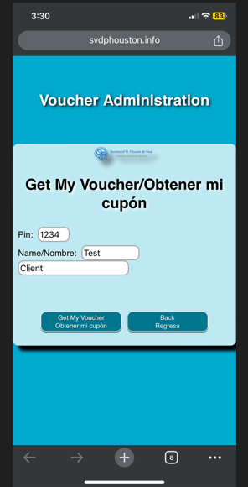
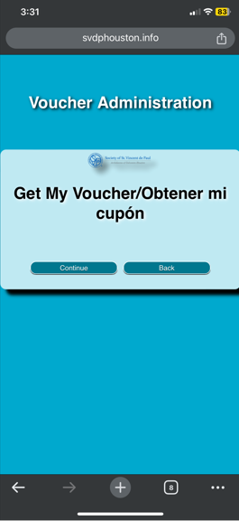
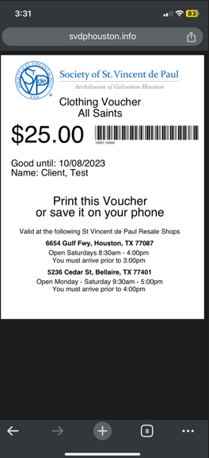
How to save a voucher on a phone
Follow the instruction in English or Spanish on the phone to get the voucher by entering the First, Last name and PIN number.

Slide 18
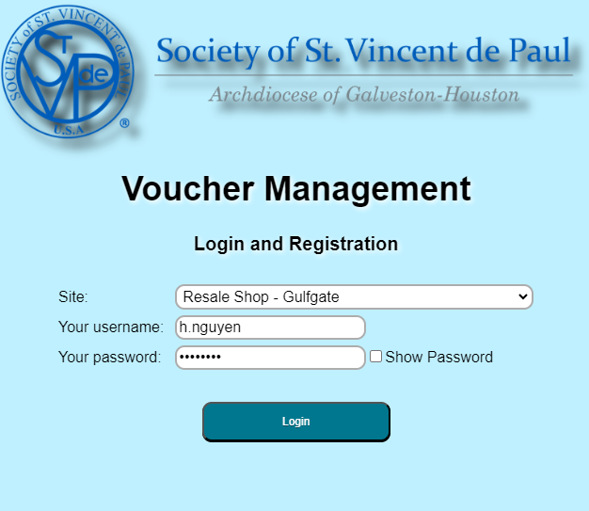
Redeeming a voucher
Log into the thrift store account

Slide 19
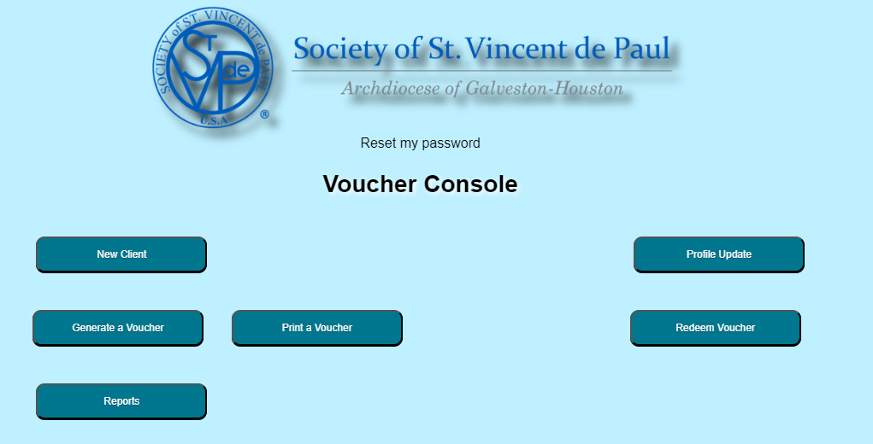
Redeeming a voucher
Click on the Redeem Voucher button

Slide 20
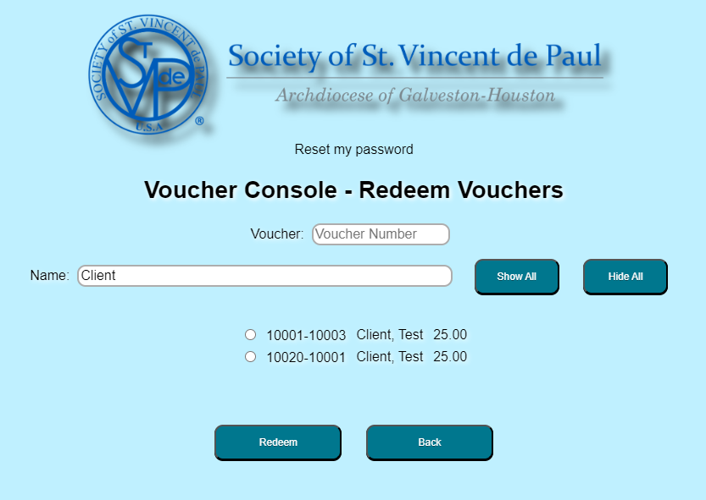
Redeeming a voucher
Search either by Last name or Voucher number.
Select the correct voucher and click the Redeem button

Slide 21
Questions?

